Slide 1



VISIONFUSION
MULTI-MODAL ANALYSIS TOOL
Overview:
Purpose: A platform for extracting actionable data and insights from images.
Key Uses: TACO dataset analysis, glioblastoma early diagnosis, simple image text extraction.

Slide 2



ANALYSIS CATEGORIES &
MODES
Categories of Insight
TACO dataset Analysis: Identify and assess gemstones.
Glioblastoma Early Diagnosis: Assist in detecting brain tumors.
Simple Image Text Extraction: Extract text from various image types.
Analysis Modes
Detection: Identifies and outlines objects with confidence levels.
Segmentation: Isolates objects from the background.
Full Analysis: Combines detection and segmentation for comprehensive results.

Slide 3

HOW IT WORKS
Steps to Analyze Your Images
Image Upload: Drag and drop your image into the tool.
Select Analysis: Choose the category and mode (Detection, Segmentation, or Full Analysis).
Pipeline for Custom Training: The tool allows users to train their own datasets, offering flexible detection and segmentation results tailored to specific needs.
Analyze: Click "Analyze" to start processing.
Results:
Visuals: Detection plots, outlined objects, segmented images.
Data: Downloadable CSV with object details, folder of segmented objects.

Slide 4
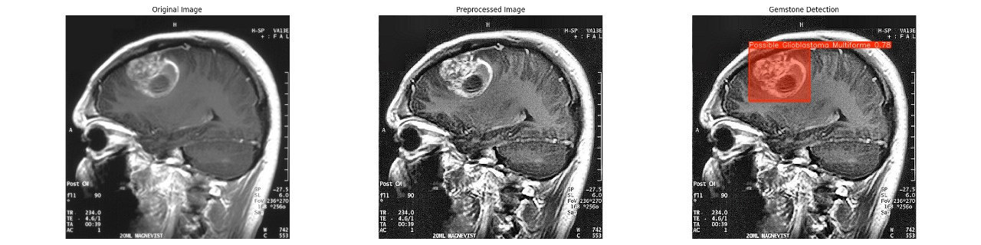
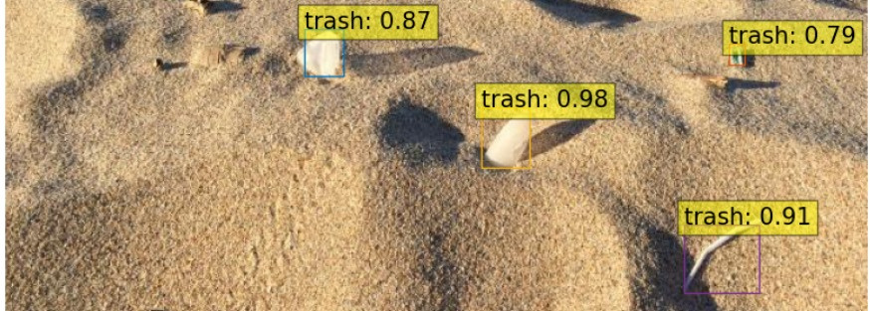
WHAT CAN THE TOOL DETECT?
What Can the Tool Detect?
Text from Images
Extracts text from documents, signs, handwritten notes, and artwork using advanced Optical Character Recognition (OCR) technology.
Tool Used: Tesseract OCR for accurate and fast text extraction.
Brain Tumors (Glioblastoma Detection)
Assists in identifying early signs of glioblastoma from medical imaging (e.g., MRI scans).
Aids medical professionals in early detection, potentially leading to quicker diagnosis and treatment.
TACO
Detects and classifies different types of waste in images.
Useful for environmental and waste management analysis, enabling efficient waste identification and processing.

Slide 5
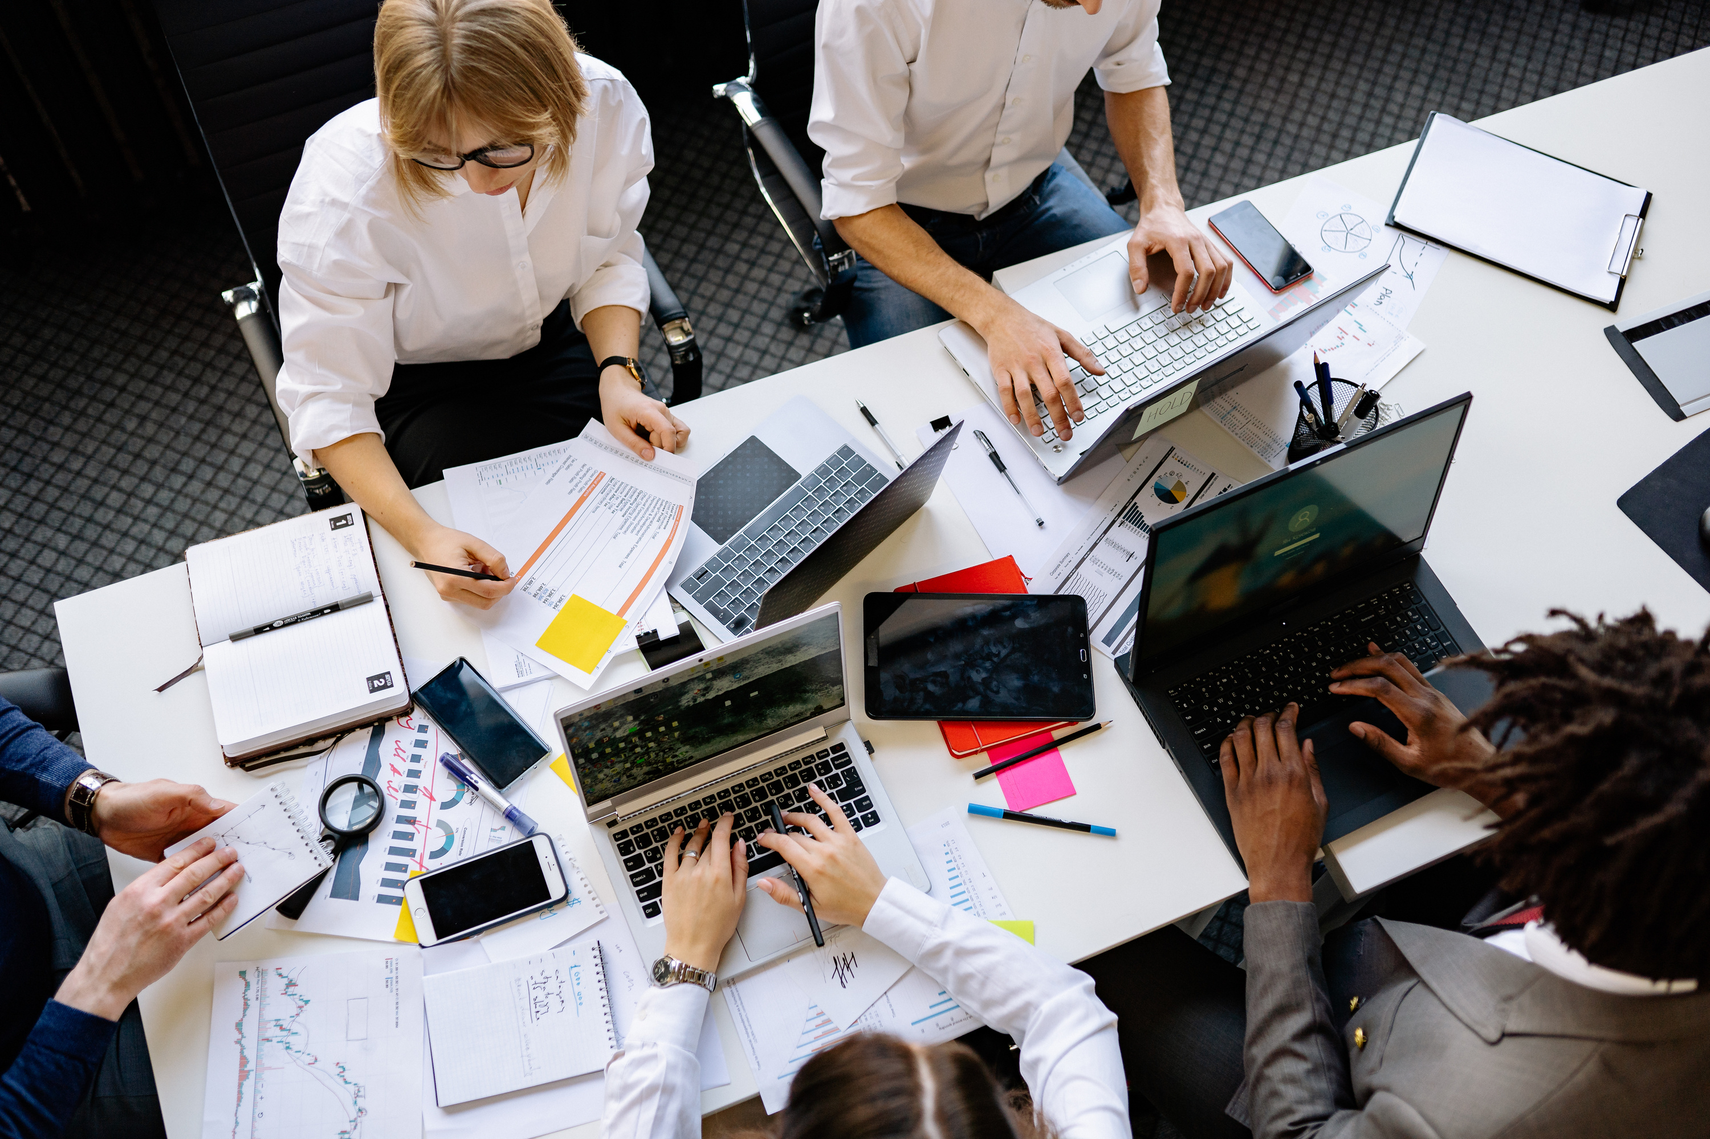
VISION & MISSION
BEHIND THE SCENES
CHALLENGES & SOLUTIONS
Image Processing: Preprocessing, normalization.
Detection & Segmentation: YOLO model for fast and efficient analysis.
Text Extraction: Tesseract OCR for accurate text recognition.
AI Summarization: LangChain and Gemini AI for insightful summaries.
Initial Hurdle: DETR’s long training times.
Adaptation: Shift to YOLO for faster training and real-time performance, with selective use of DETR where beneficial.

Slide 6

FUTURE DIRECTIONS
Future Possibilities
Advanced Summarization: Richer, more detailed summaries with LLM models.
Expanded Capabilities: Color analysis, shape detection, and more.
Database Integration: Secure storage and organization of results.
Get Involved
Explore the project repository, contribute improvements.
Visuals: Repository links, contact information.

Slide 7
CONTRIBUTIONS
Anubhav Mazumder (22051145)
Debjit Mandal (22051069)
Project Lead: Directed conceptualization, development, and strategic oversight.
Model Optimization: Led the integration and tuning of YOLO and DETR models to balance performance and accuracy.
UI/UX Designer: Designed an intuitive interface to streamline user interaction.
Text Extraction: Spearheaded the implementation of the OCR engine for accurate text recognition.
Summarization Feature: Developed the summarization system, using language models to create insightful reports.
Documentation: Managed project documentation and
communication.

Slide 8

THANK YOU
FOR YOUR ATTENTION

